Slide 1
Lab 2 Programming Essentials in C
DR : Ghada
Eng : Gehad Mustafa
Eng : Somaya

Slide 2
Contents
Input Output (I/O)
Comments
If ... Else
Short Hand If Else
Assignment Operators
Logical Operators
Bitwise Operators
Misc Operators

Slide 3
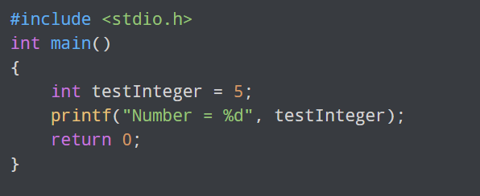
Input Output (I/O)

Slide 4
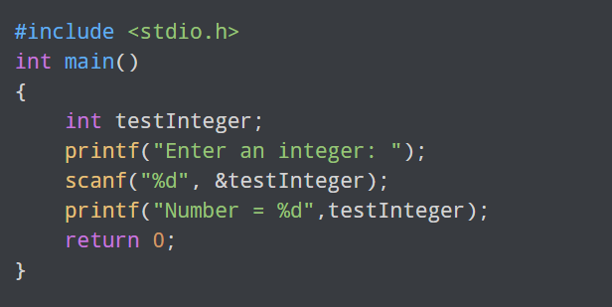

Input Output (I/O)

Slide 5

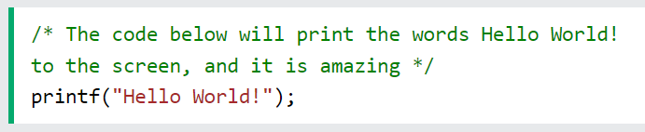
Comments
Comments can be singled-lined or multi-lined.
Single-line Comments :
Single-line comments start with two forward slashes (//).
Multi-line Comments:
Multi-line comments start with /* and ends with */.

Slide 6
If ... Else
if Statement
else Statement
else if Statement

Slide 7
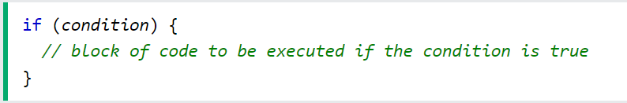
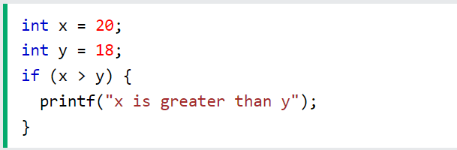
If Statement

Slide 8
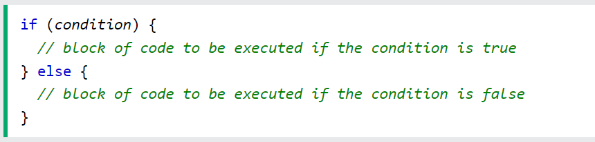
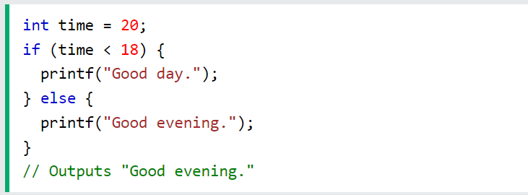
else Statement

Slide 9
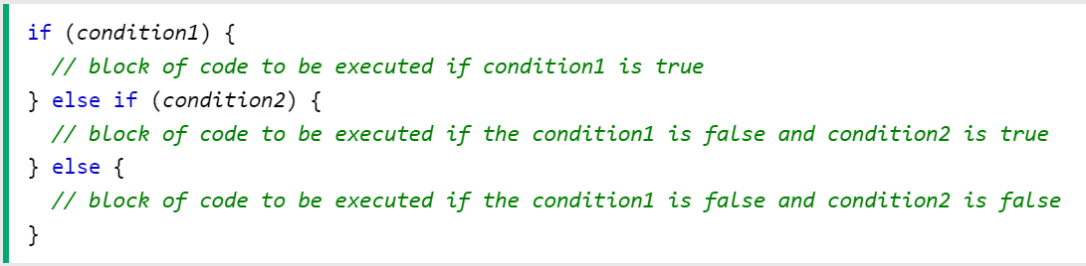
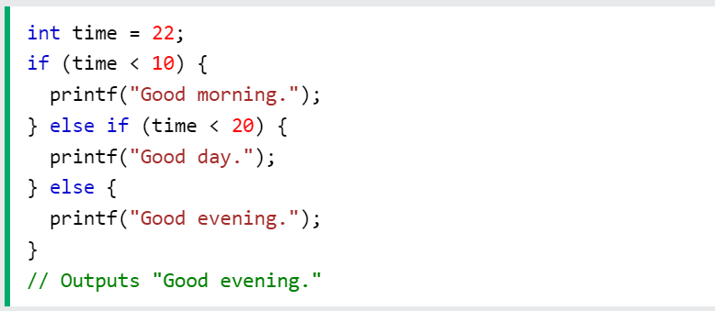
else if Statement

Slide 10

Short Hand If Else
Syntax:
variable = (condition) ? expressionTrue : expressionFalse;
EX:

Slide 11
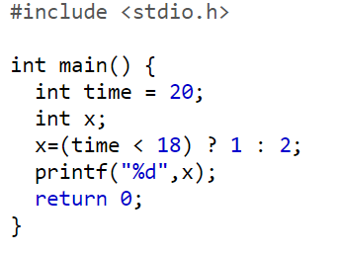
Short Hand If Else

Slide 12
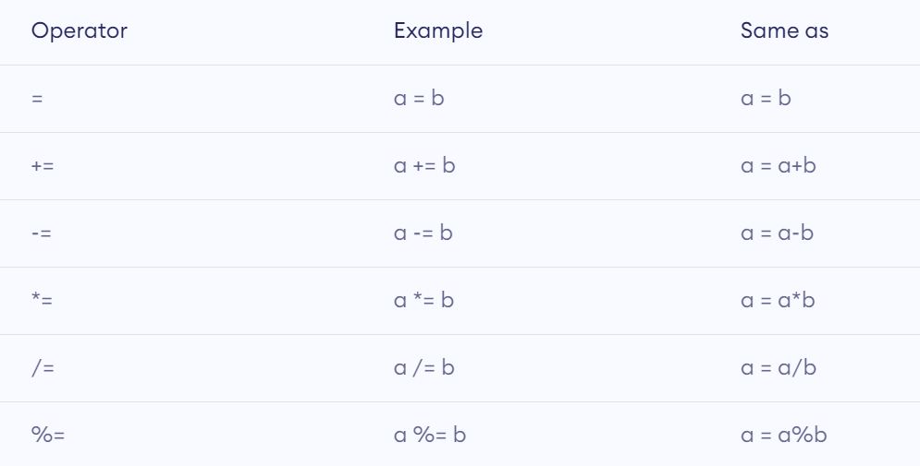
Assignment Operators

Slide 13
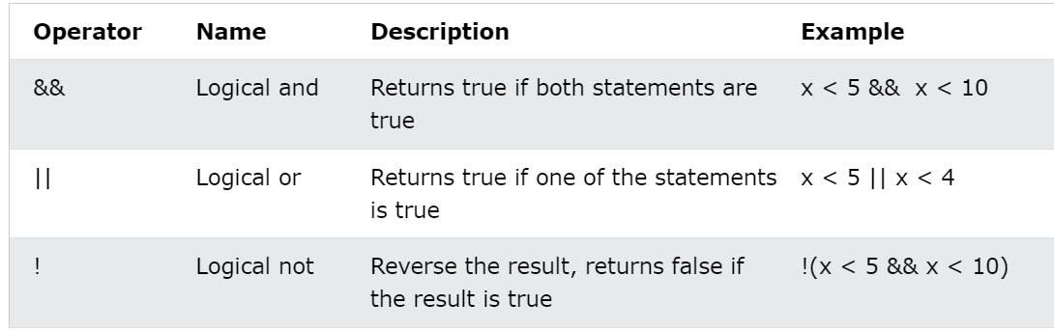
Logical Operators

Slide 14
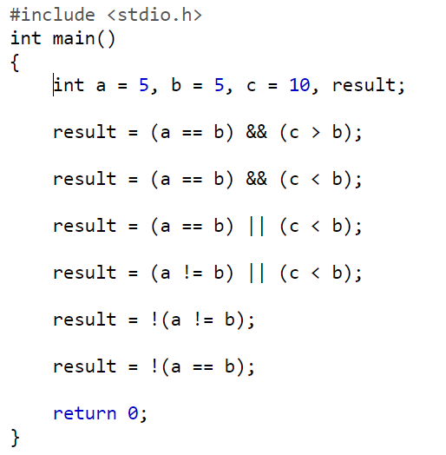
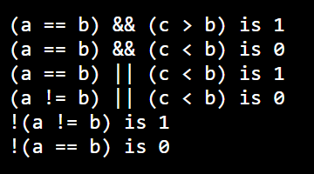
Try This

Slide 15
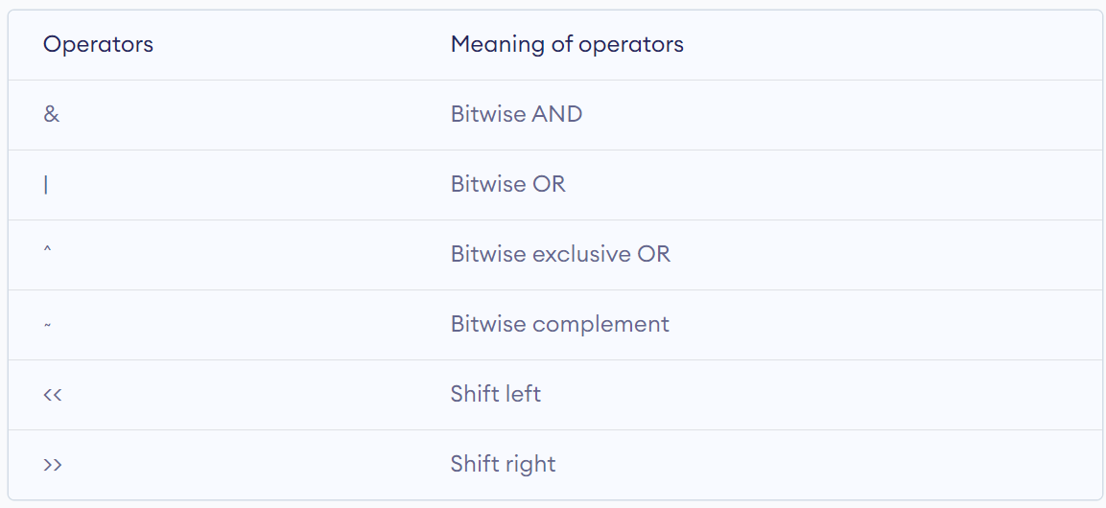
Bitwise Operators

Slide 16
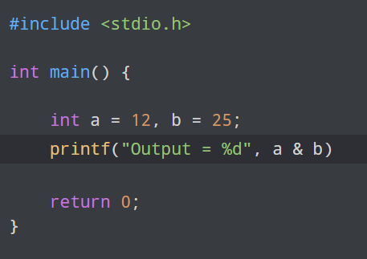
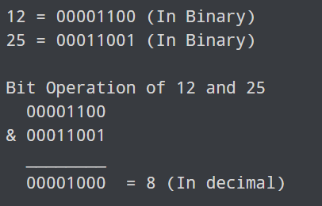
Bitwise AND Operator &

Slide 17
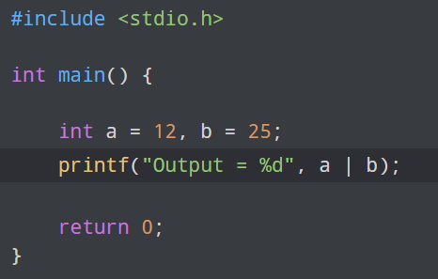
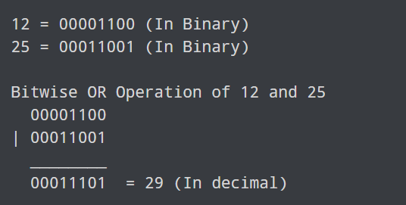
Bitwise OR Operator |

Slide 18
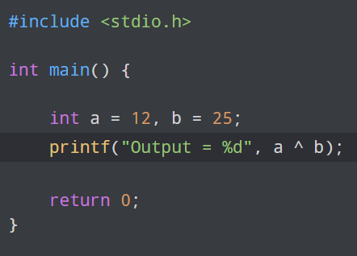
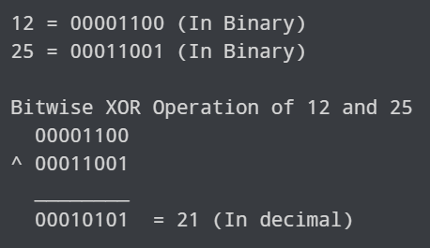
Bitwise XOR (exclusive OR) Operator ^

Slide 19
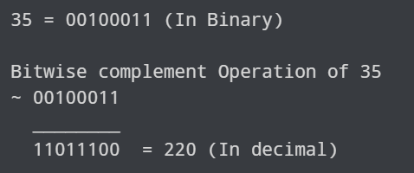
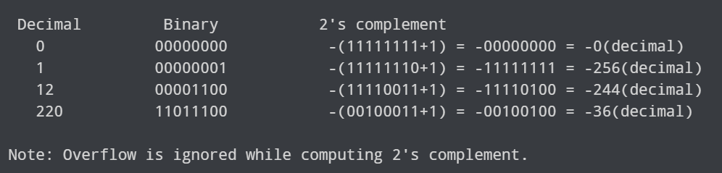
Bitwise Complement Operator ~

Slide 20
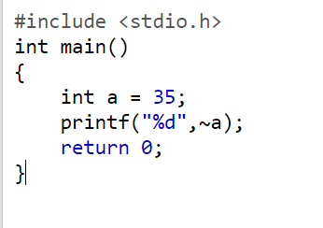
Bitwise Complement Operator ~

Slide 21
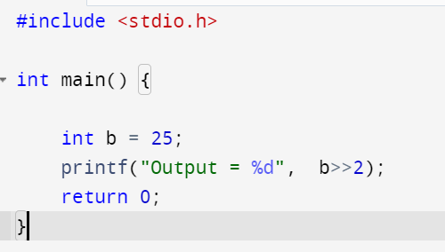
Shift Operators
Left shift operator : (<<)
11010100 << 0 = 11010100 (212)
11010100 << 1 = 110101000 (424)
11010100 << 2 = 1101010000 (848)
Right shift operator : (>>)
11010100 >> 0 = 11010100 (212)
11010100 >> 1 = 01101010 (106)
11010100 >> 2 = 00110101 (53)
(6)

Slide 22
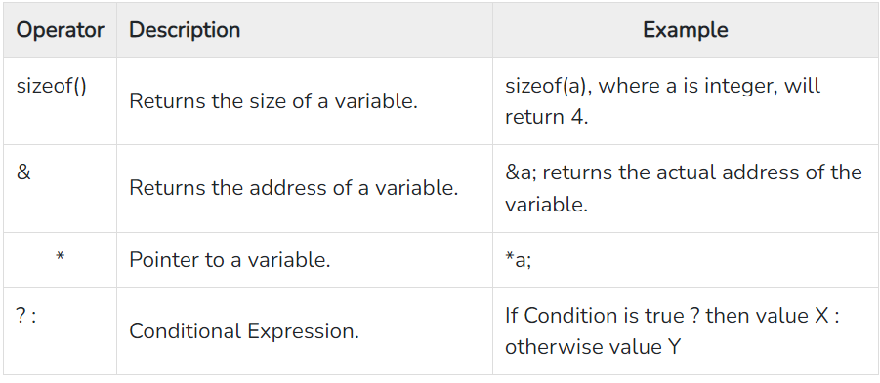
Misc Operators

Slide 23
THANKS

